Slide 1


Statistical Analysis of a Chess Player
using Data Science Pipeline.
Paper ID : P011

Slide 2
Presented By
Yogen Ghodke

Slide 3
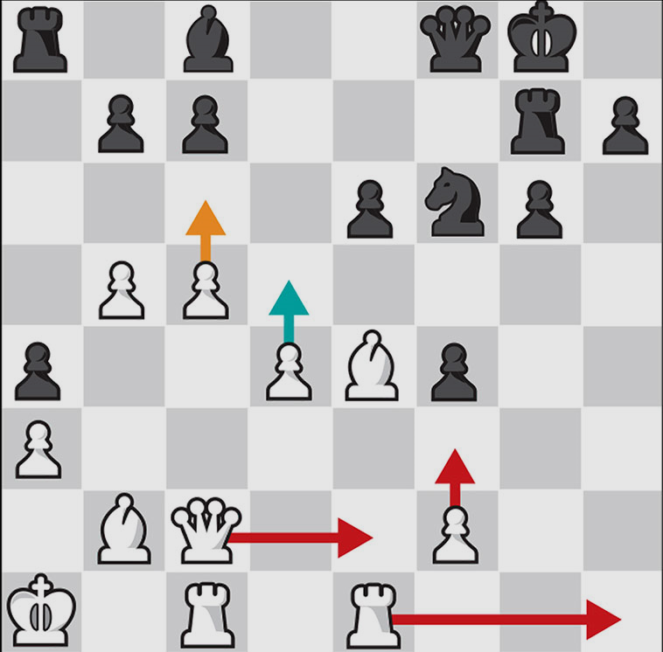


,
Introduction
$$\sum_{i =1}^{n}{{10}^{123}} ≈$$
$$∞$$
Chess is a game with infinite possibilities and every game played produces large amounts of data.

Slide 4
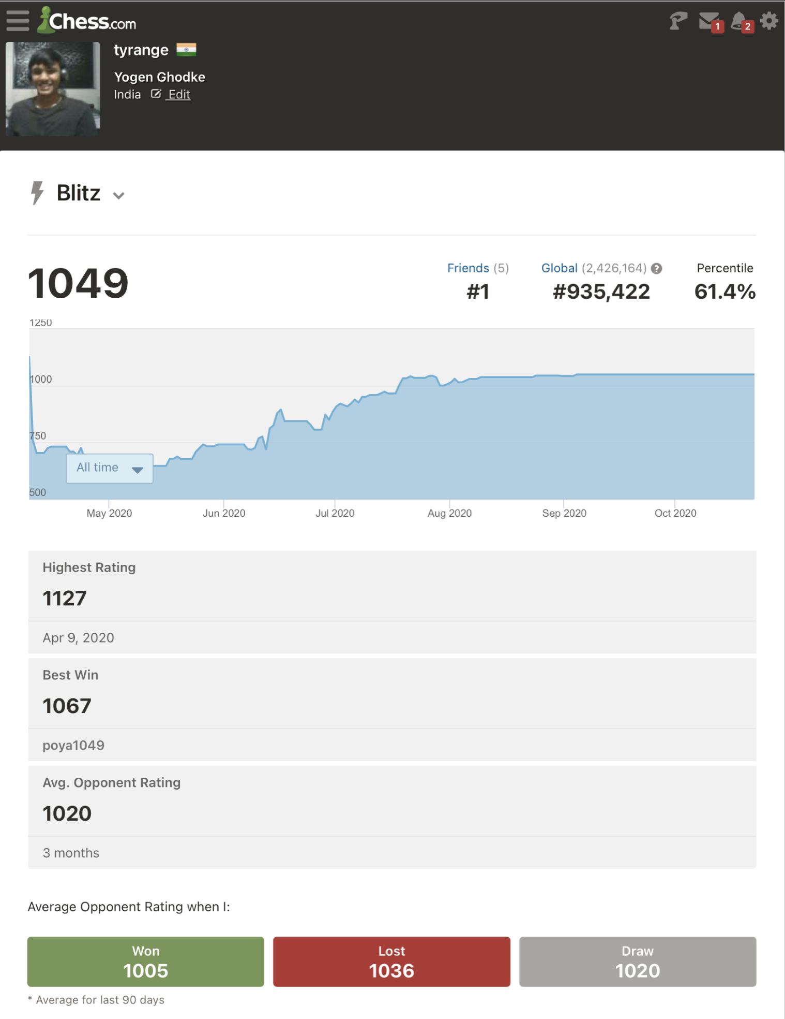
,
Previous System Drawbacks
There is no tool available in the market which provides an in-depth analysis of a player’s overall games.
Notes:
Chess websites collect large amounts of user data but never make proper use of it.

Slide 5
,
Motivation
Provide Chess players a tool to improve their chess game with
assistance from several Machine Learning and Data Science techniques, by studying their previous games.

Slide 6
,
Objectives
Finding the player’s Strengths and Weaknesses.
Detailed analysis of your opponents moves before the match.
3. Next move Predictions based on previous games played.
4. See the least and most favourite Chess Opening Lines.
5. Find which moves attributed to Wins , Losses or Draws.
6. Visualising the statistics related to the account in great detail.
Help the player improve their endgames.
Play a Live game and get the analysis of the game in real-time.

Slide 7
,
Main Menu
Player Analysis
Opponent Comparison
Roll Credits
Exit

Slide 8
,
Module - 1 : Player Analysis
Function :
- This module provides an in-depth analysis of the player’s statistical data, based on the games that the player has already played.
- It shows rating graphs, most played and least played openings, player strengths and weaknesses and wins, draws and losses while playing as black / white.
Notes:
.

Slide 9
,
Module - 1 : Player Analysis
Working :
The user has to input their / opponents ChessDB username.
All of the game data associated with the username is downloaded using API calls.
Unwanted data is filtered out and required data is refined (checking of null values etc.)

Slide 10
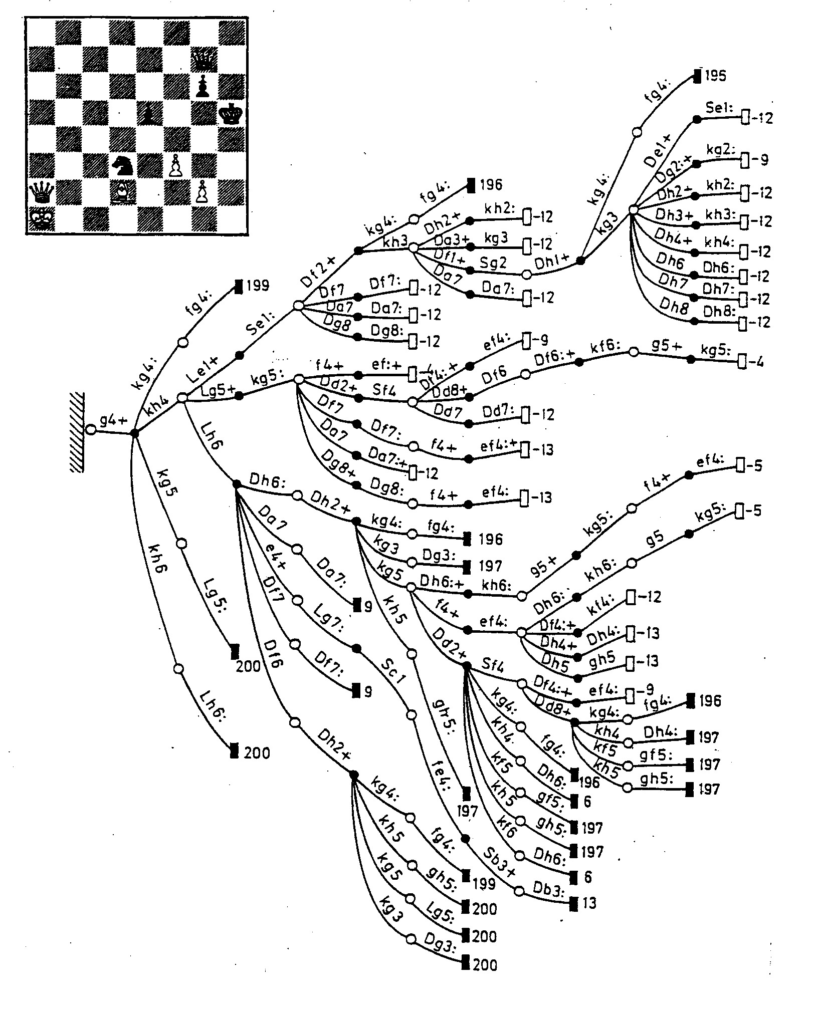
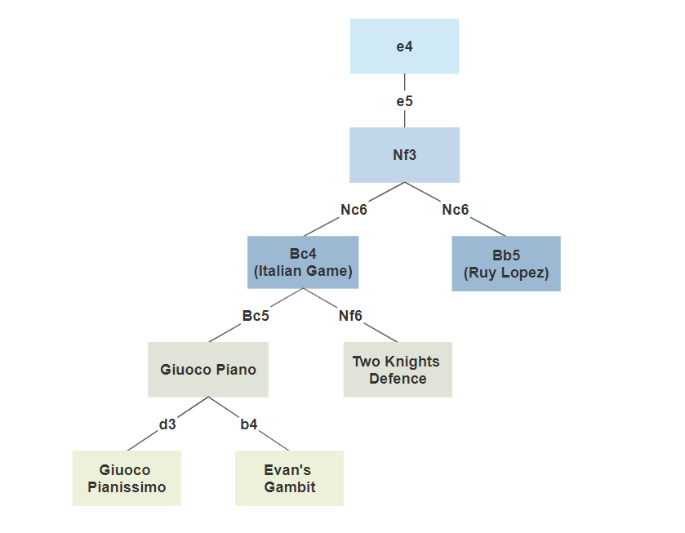
,
Module - 1 : Player Analysis
Working :
A Decision Tree classifier, classifies each games into clusters of related openings.

Slide 11
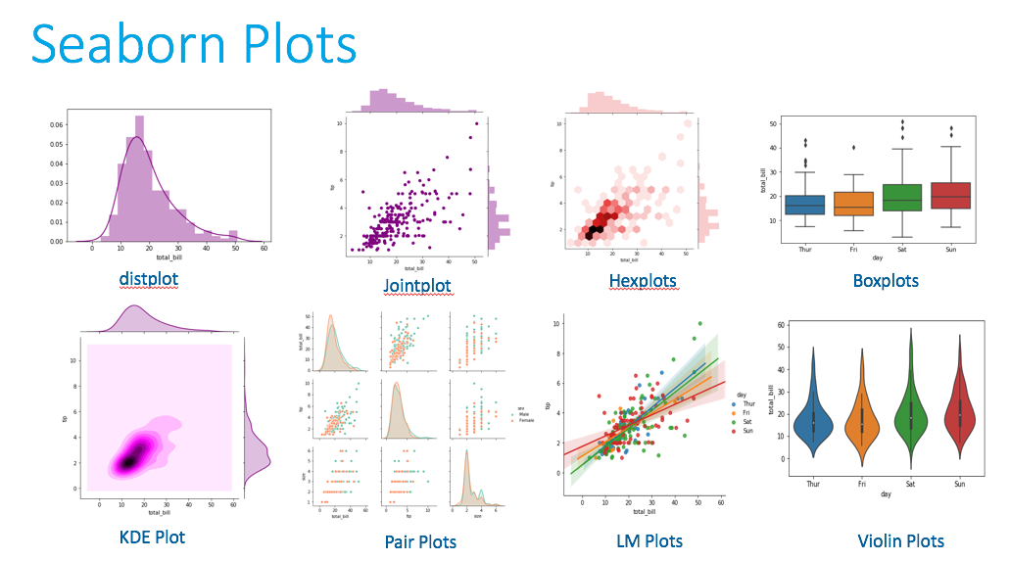
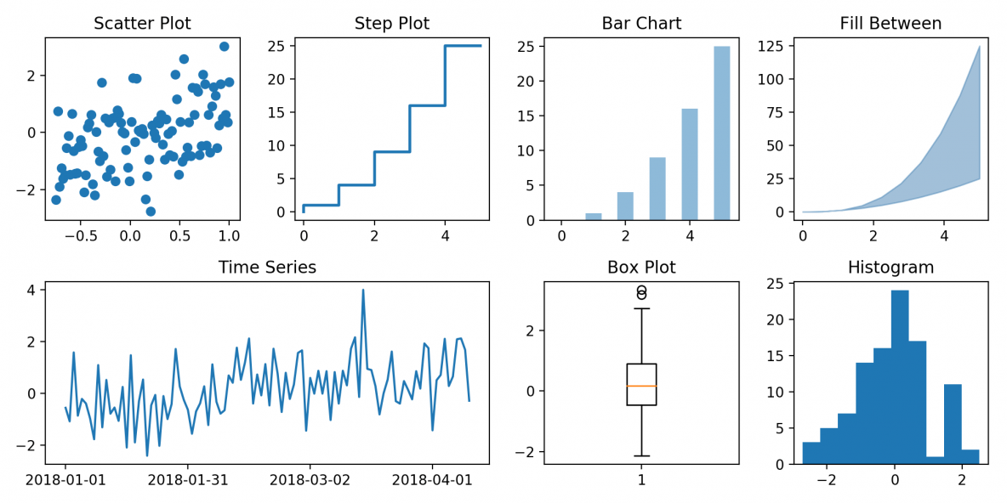
,
Module - 1 : Player Analysis
Working :
These clusters are used to plot the data points ( using Seaborn and Matplotlib ) and calculate win probabilities as white or black.

Slide 12
,
Module - 2 : Opponent Comparison
Function :
- This module can be used to study the user’s chances of winning against a particular opponent.
- It provides an in-depth, side-by-side comparison of the user’s vs opponent’s statistical data.
- It shows rating graphs, opponent’s strengths and weaknesses and how the user can prepare before a match against the specified opponent.
Notes:
.

Slide 13
,
Module - 2 : Opponent Comparison
Working :
System will input the user’s and opponent’s Chess DB username.
All of the game data associated with the usernames is downloaded using API calls.
All other steps are the same as Module – 1, except that it will show a side by side comparison of the derived data.
Notes:
.

Slide 14
,
Module – 3 & 4 : Roll Credits and Exit
Function :
Roll Credits will give information about the program version, details about the developers and credits to the staff members.
Exit will clear all temporary files and exit the program.
Notes:
.

Slide 15

,
Typical Data Science Pipeline
1. Data Acquisition
2. Data Cleansing
3. Data Analysis
4. Data Visualisation
5. Insights, Conclusions
6. Deployment
Public APIs of Chess sites
NumPy , Pandas
Decision Tree Classifiers
Seaborn, Matplotlib
Front End UI / UX
Tkinter GUI library

Slide 16
,
Data Acquisition
Chess.com Public API
Lichess API
ChessDB API
Opening Explorer Datasets
Custom PGN Datasets

Slide 17
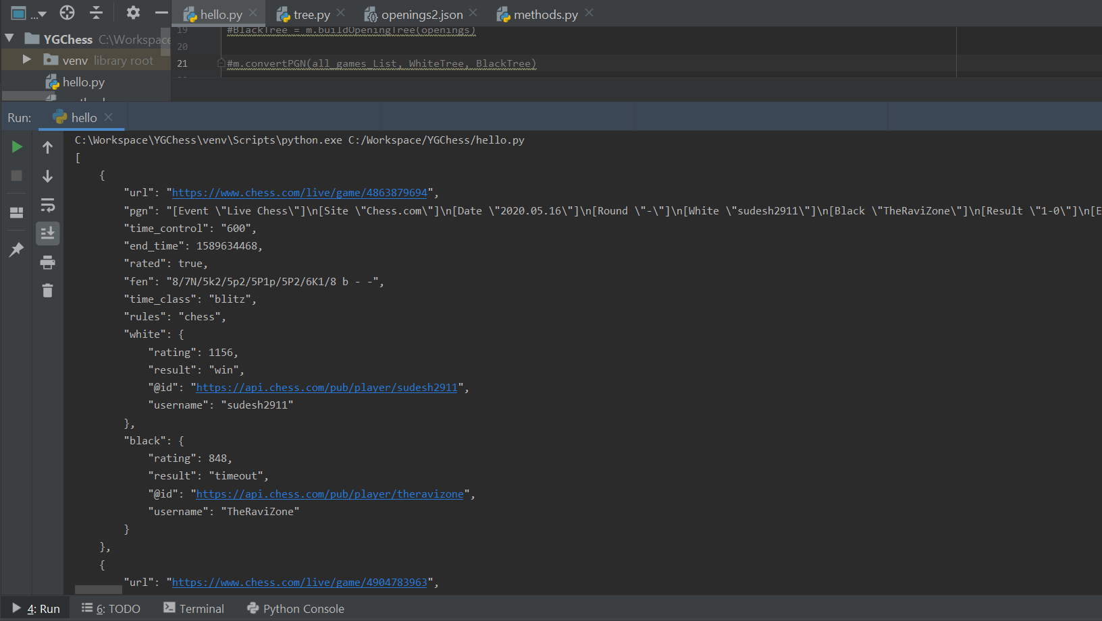

,
Data Acquisition

Slide 18
,
Data Cleansing
Remove all unnecessary data.
Sort, Reorder and Reshape the Data.
Store it in usable CSV or JSON format.
Implement proper File Handling and caching to retrieve the data from stored files.

Slide 19
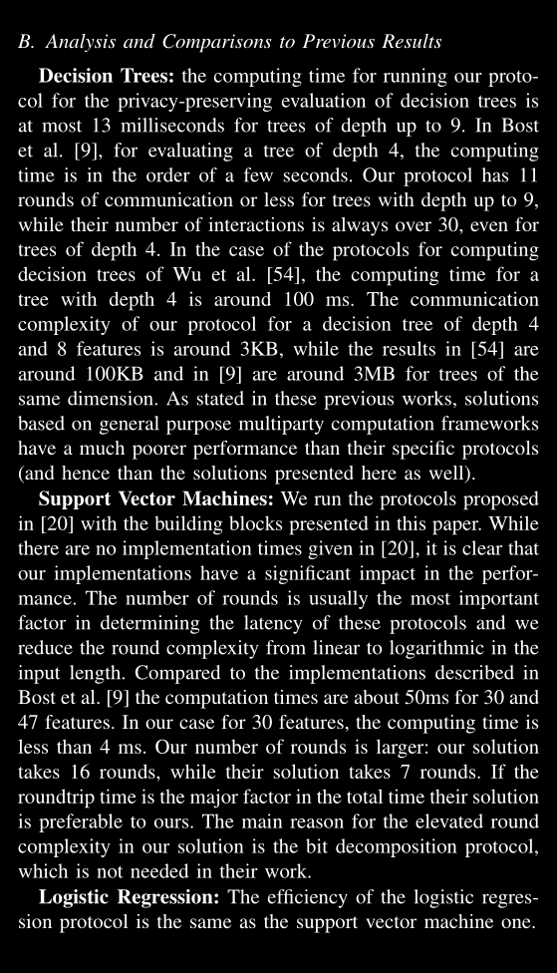
,
Data Analysis
Decision Tree Algorithm for Opening Moves Clustering.
Support Vector Machines for Candidate
Move Generation and Threat Detection.
Logistic Regression for game prediction.

Slide 20
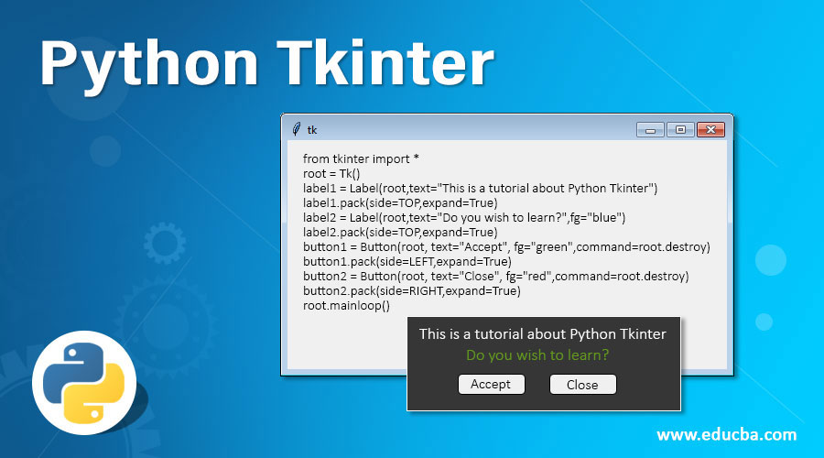
,
Front End (GUI)
Tkinter - Similar to Windows Visual Basic

Slide 21
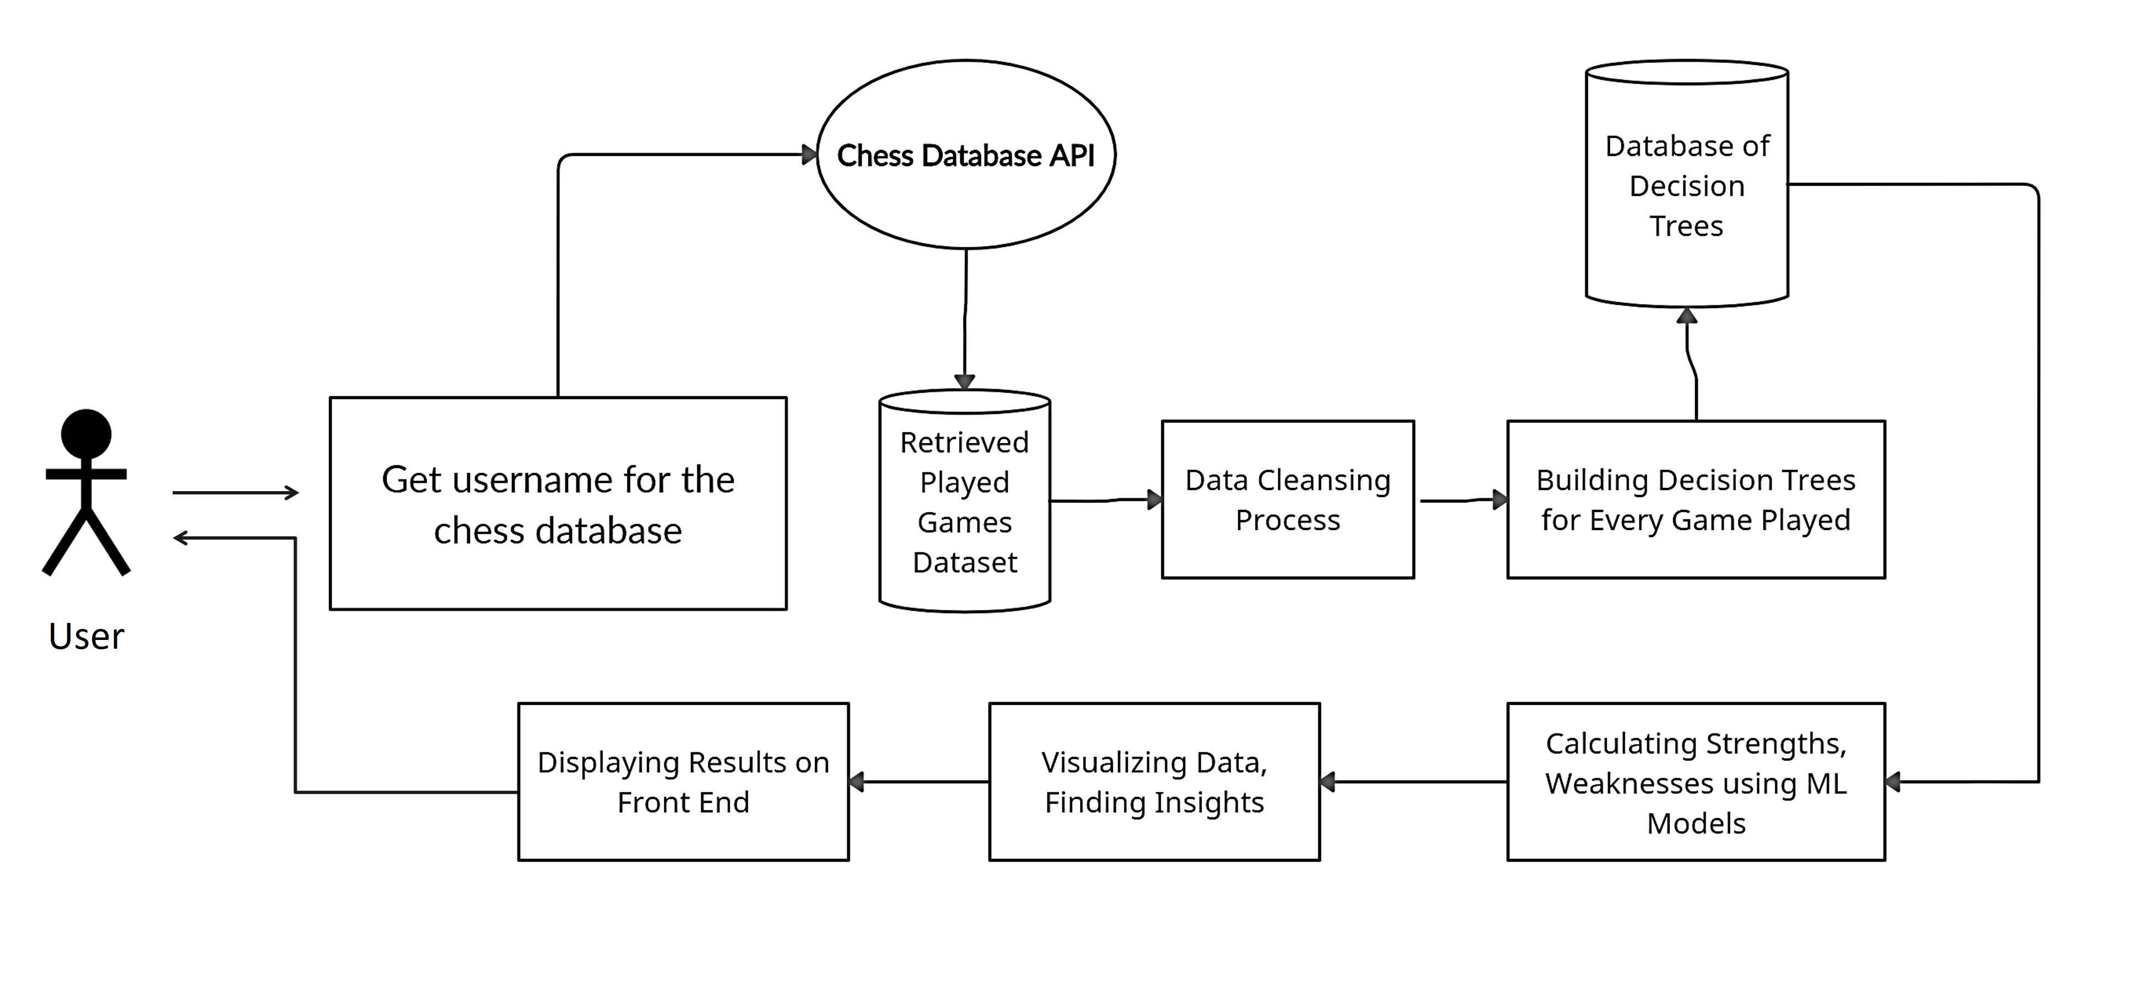
,
System Architecture

Slide 22
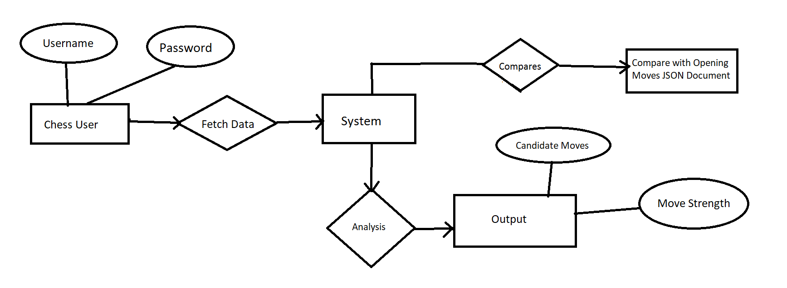
,
ER Diagram

Slide 23
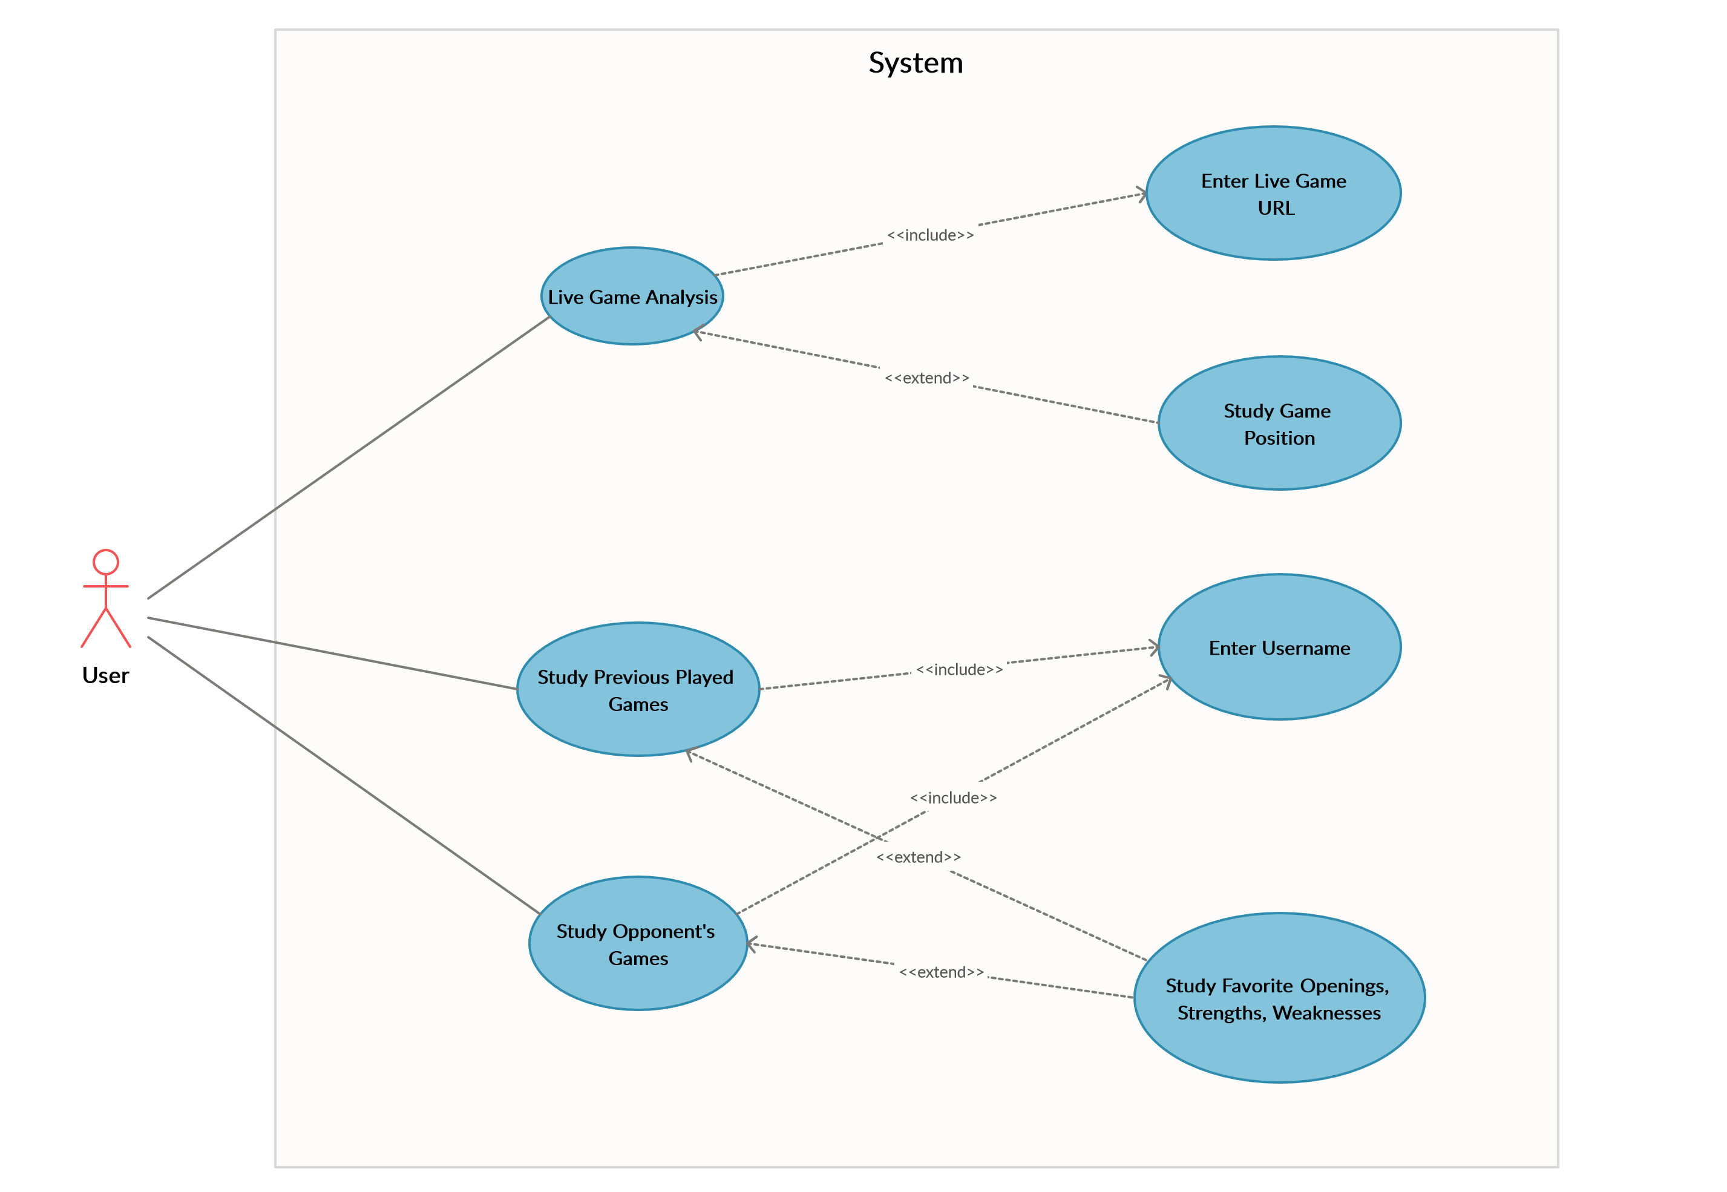
,
UML Use Case Diagram

Slide 24
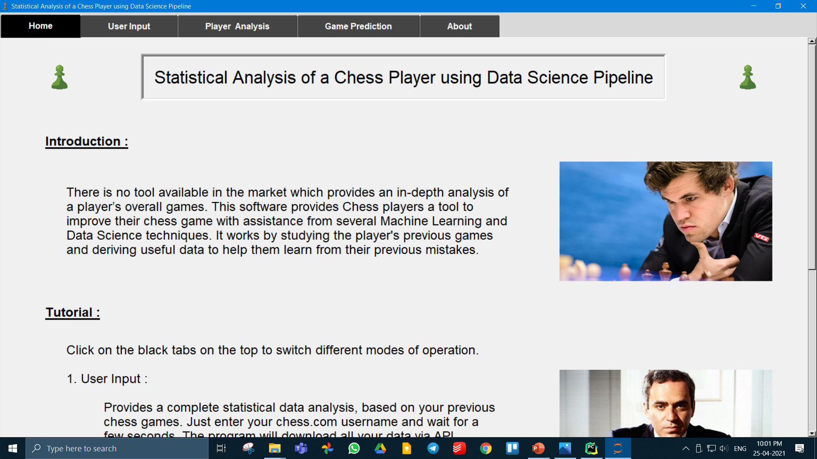
,
Project Screenshots

Slide 25
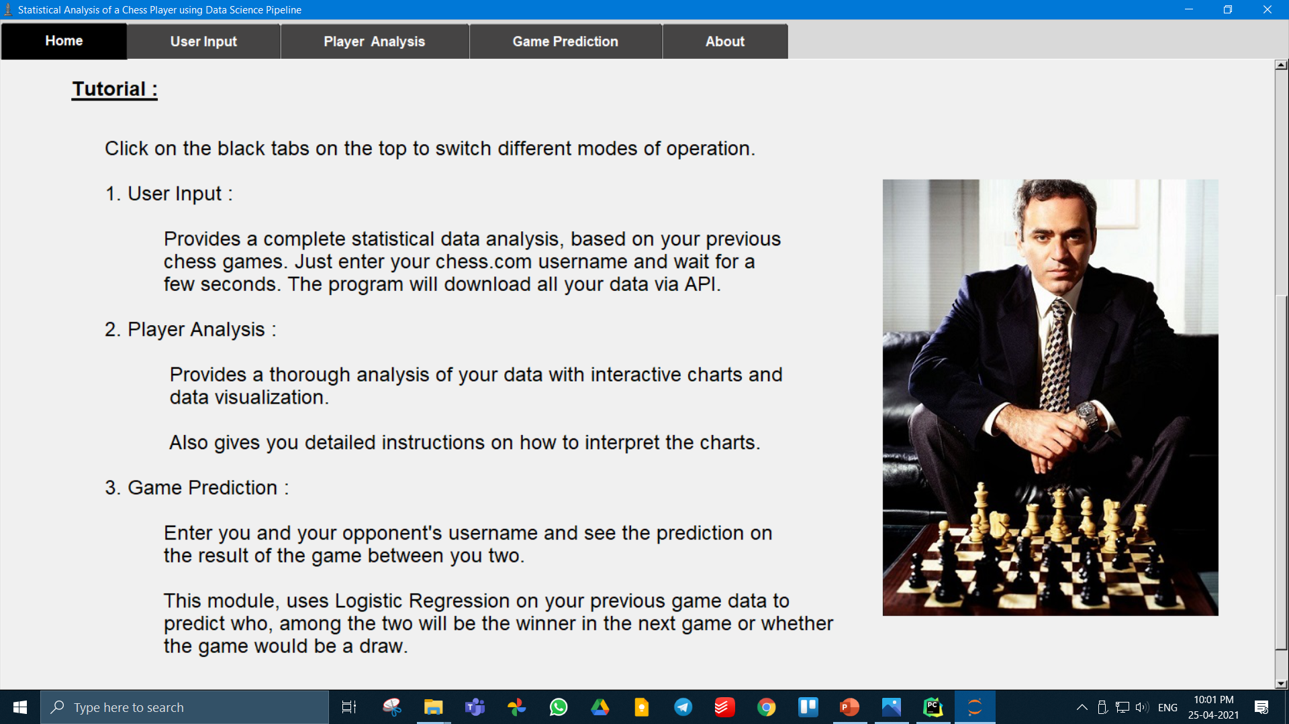
,

Slide 26
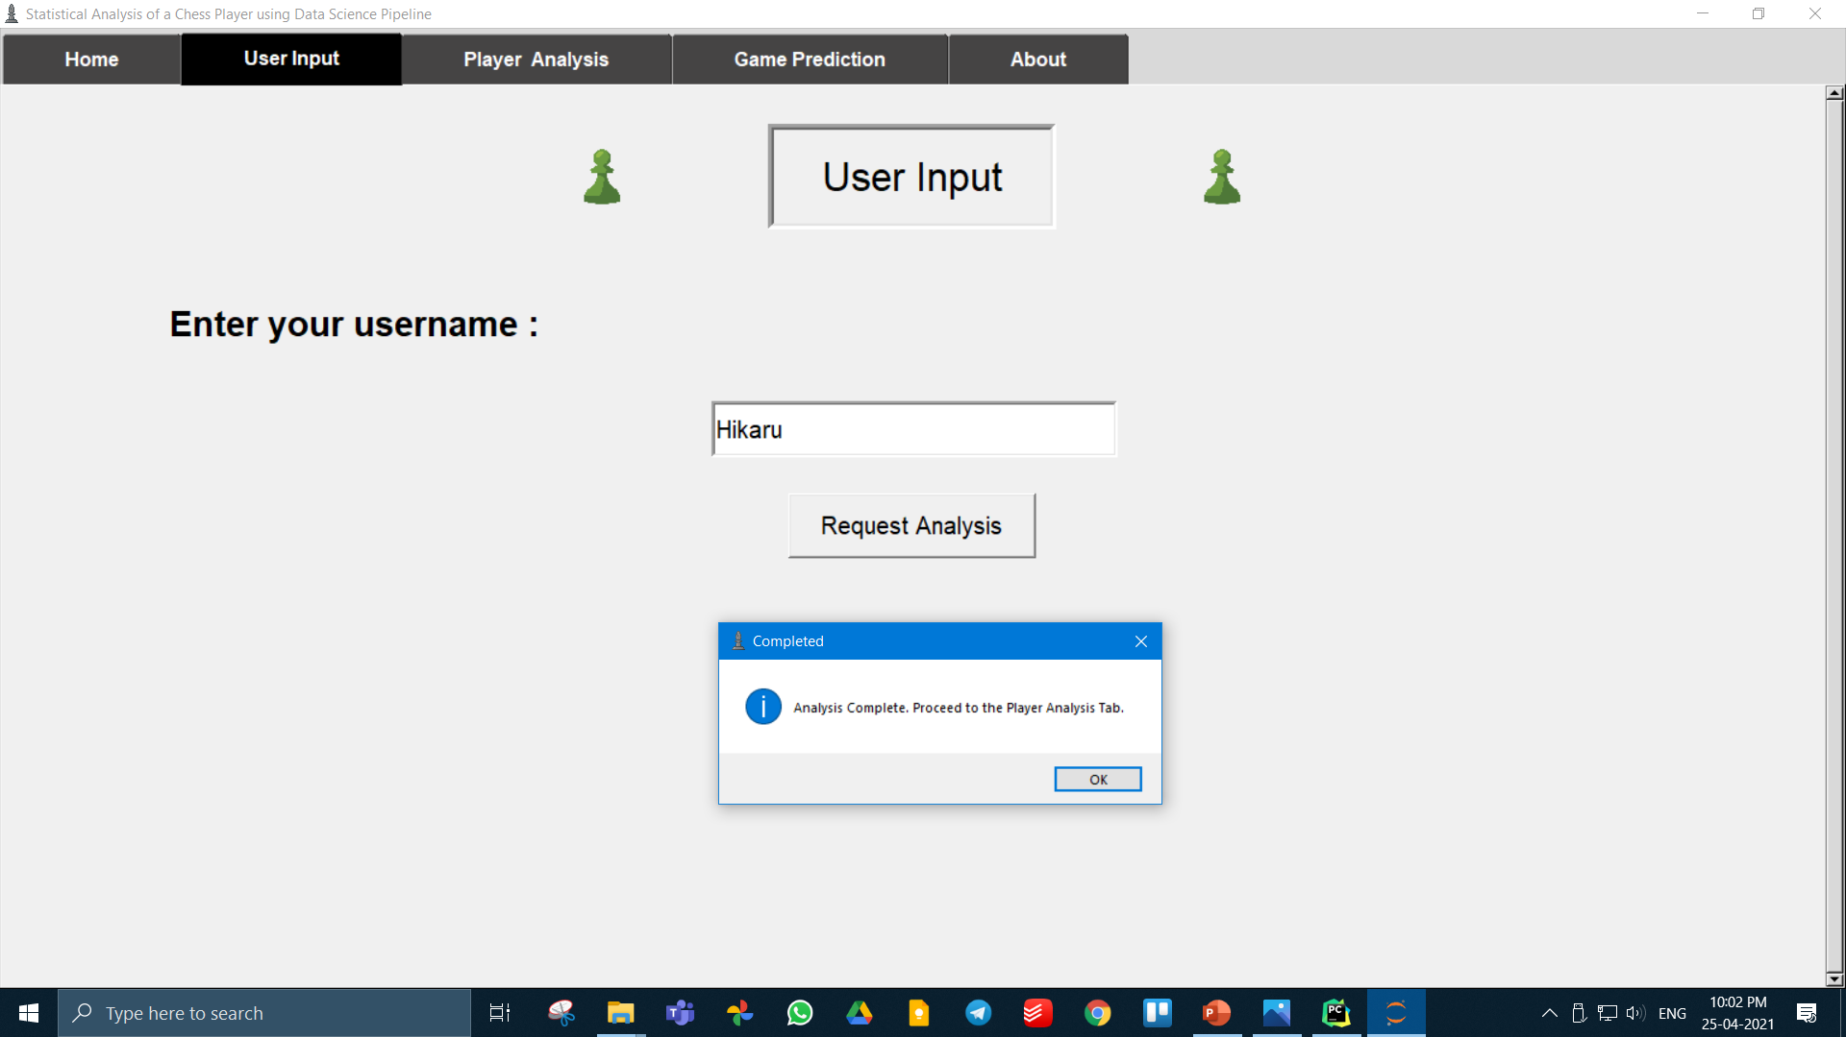
,

Slide 27
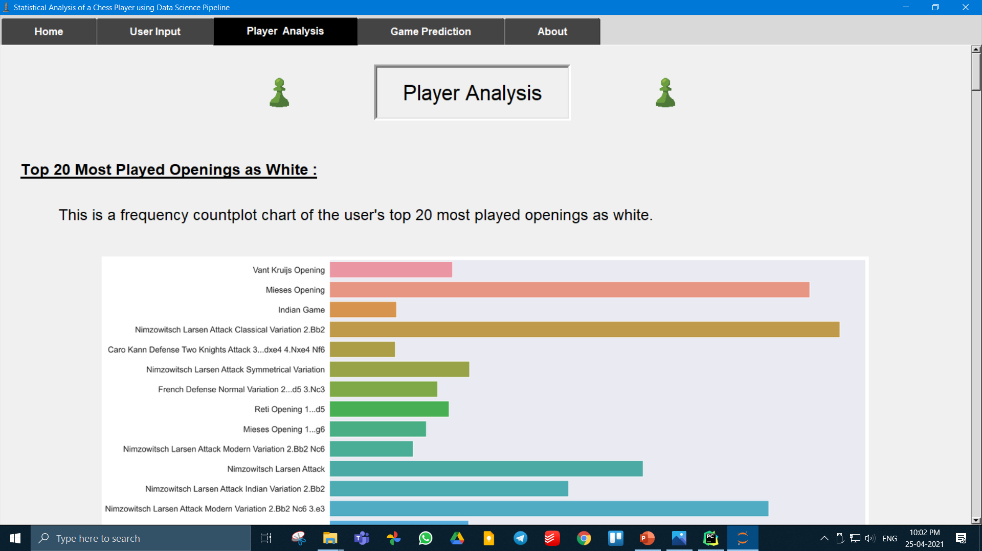
,

Slide 28
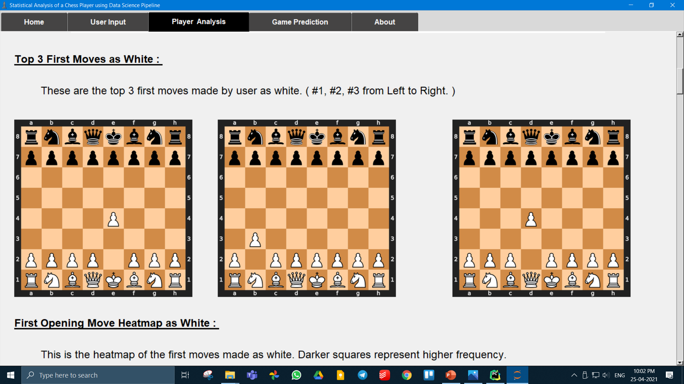
,

Slide 29
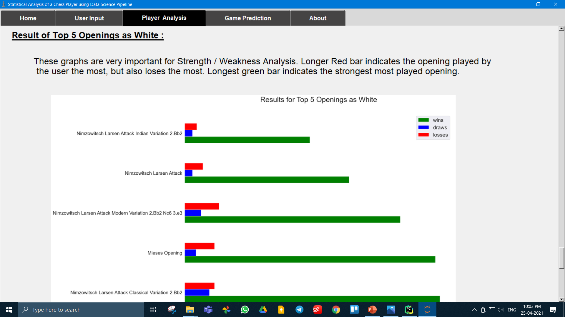
,

Slide 30
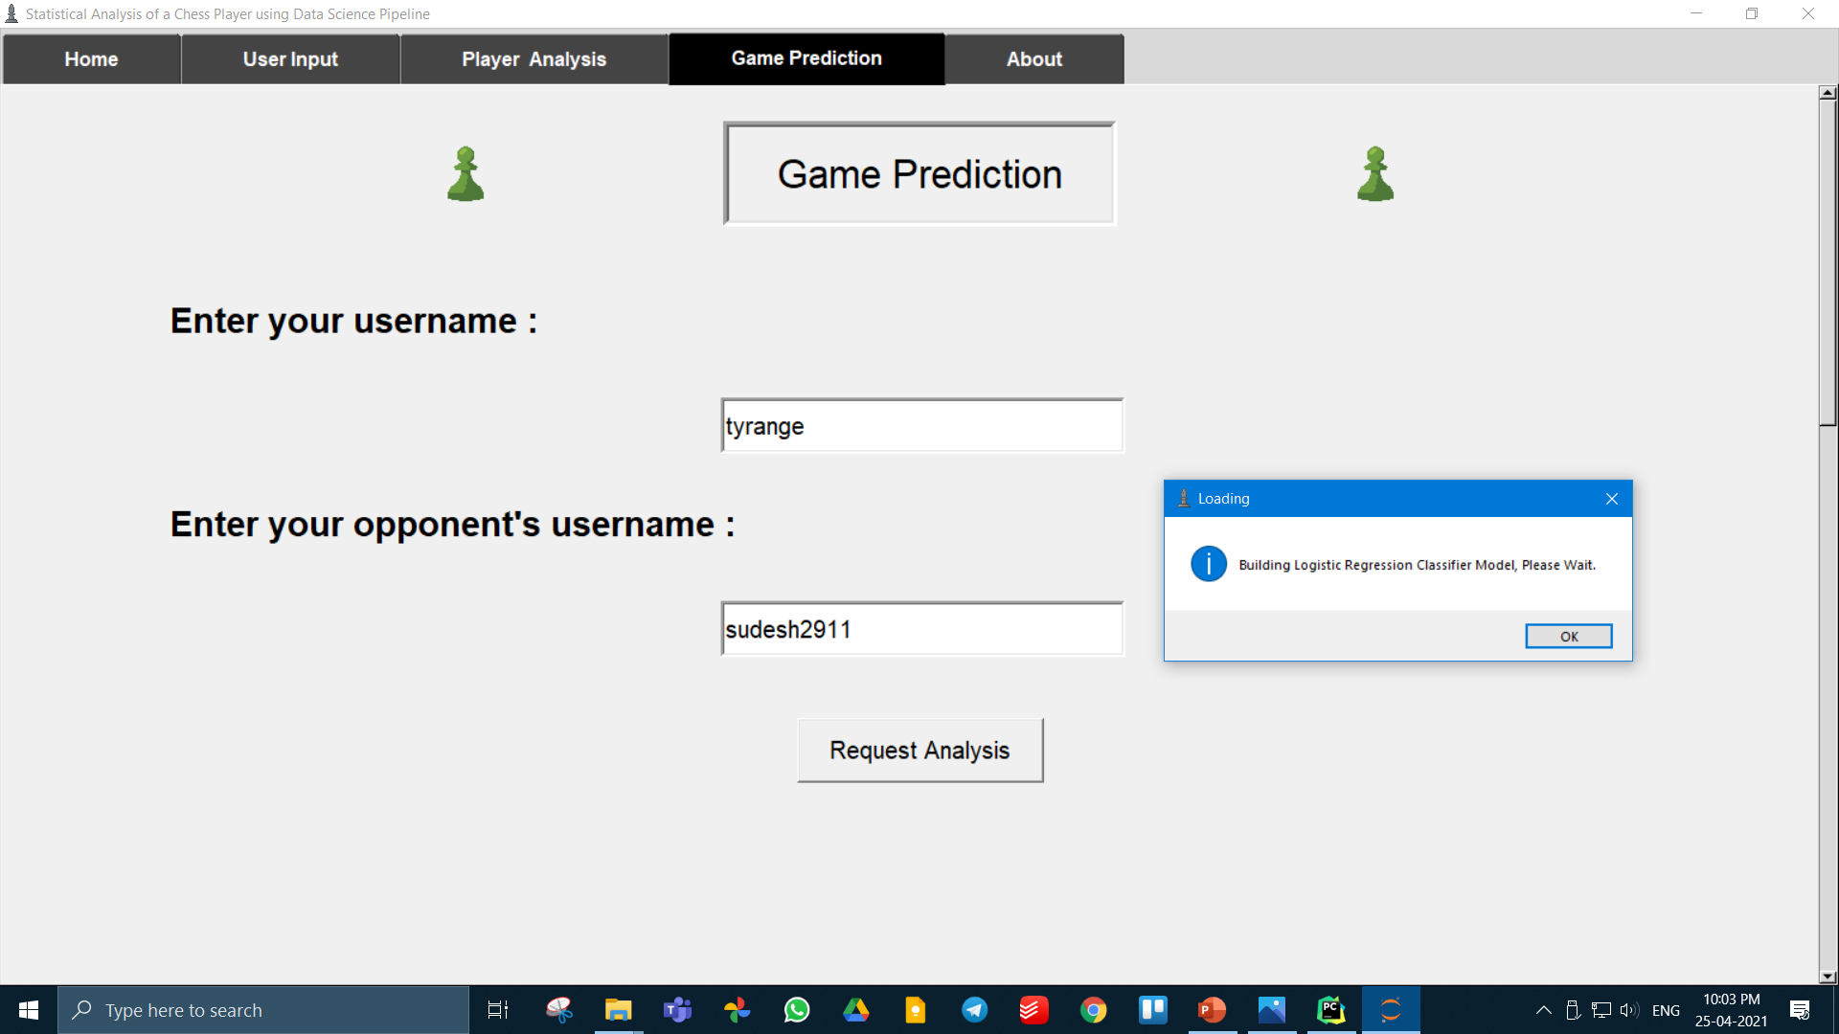
,

Slide 31
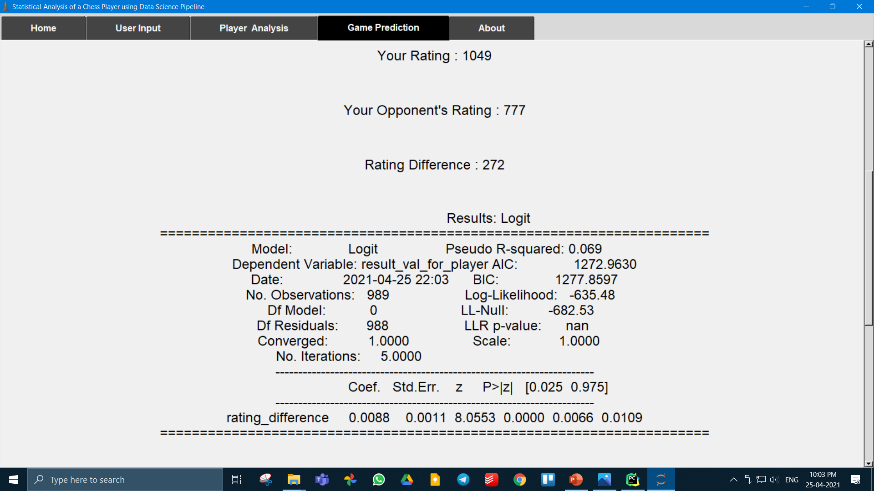
,

Slide 32
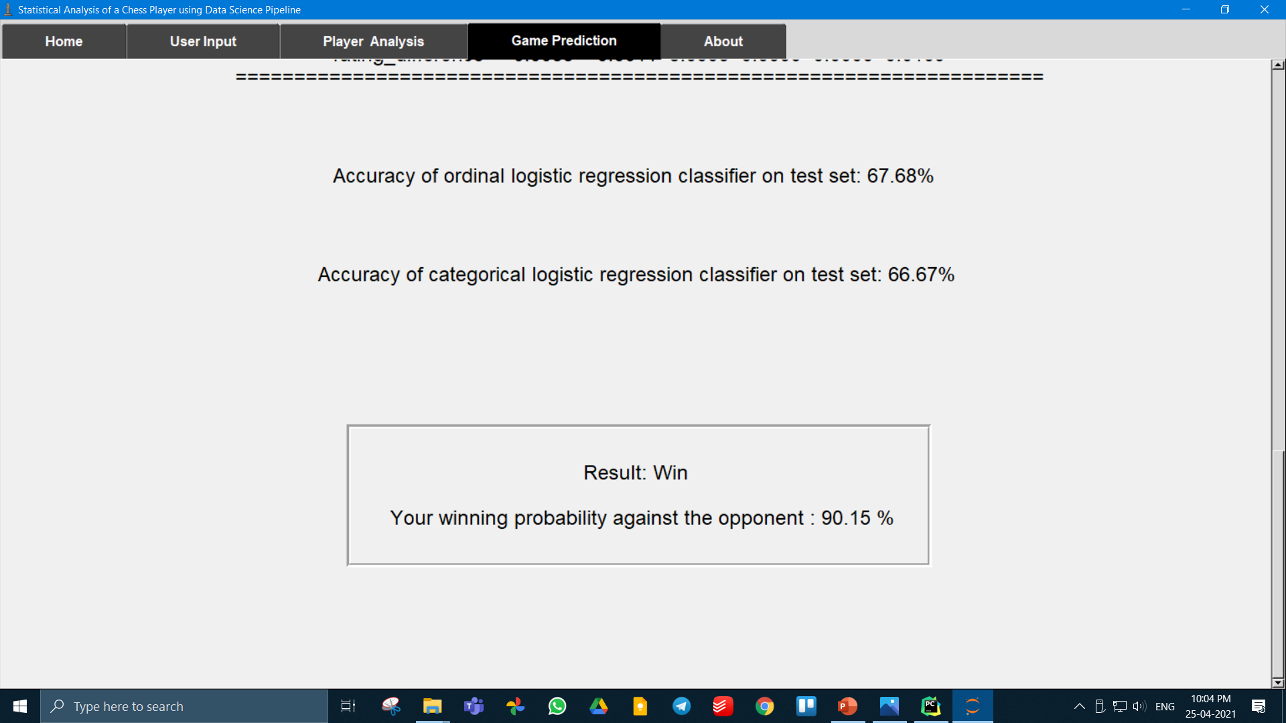
,

Slide 33
,
Additional Features that could be implemented in future updates.
Data Caching : Instead of making API calls every time, the system can use the downloaded data and just get the newly updated data to speed up processing time.
Interactive Chess Board : Instead of using the Lichess practice chess board to study the positions, an interactive study board could be embedded into the program itself, to save the hassle.
Adaptive Resizing : Use relative positioning instead of grid based positioning which adapts, when the window size changes.

Slide 34
,
Paper Publication Details
"Review on Statistical Analysis of a Chess Player using
Data Science Pipeline" was published in International Journal of Scientific Research in Engineering and Management (IJSREM) Volume 04, Issue 12, December 2020.

Slide 35
,
Literature Review
[1] Decision Trees are a type of Supervised Machine Learning where the data is continuously split according
to a certain parameter. The tree can be explained by two entities, namely decision nodes and leaves. The
leaves are the decisions or the final outcomes. And the decision nodes are where the data is split.
[2] Decision support systems using Machine Learning can be used in the context of chess endgames for
move prediction and suggestion. The analysis of order flow provides many challenges that can be
addressed by Machine Learning (ML) techniques in order to determine the optimal dynamic endgame
strategy. The model should identify strong predictors that determine a positive/negative outcome.
[3] Many real-world datasets are incomplete due to factors such as data collection failures or misalignments
between fused datasets. Visualizations of incomplete datasets should allow analysts to draw conclusions
from their data while effectively reasoning about the quality of the data and resulting conclusions.
[4] ML’s deep searching enables the depiction of chess positions after more than 10 moves. Therefore it is
capable of analyzing long-term positional advantages of a game. An intuitive way is to visualize the chess
decision tree. These readability problems should be well handled in chess visualization.
[5] High volumes of data can be easily collected from board games like chess. Embedded in these big data is
valuable information or knowledge. This calls for machine learning techniques for supporting advanced
knowledge discovery from these big heterogeneous data.

Slide 36
Literature Review
[1] Decision Trees are a type of Supervised Machine Learning where the data is continuously split according to a certain parameter. The tree can be explained by two entities, namely decision nodes and leaves. The leaves are the decisions or the final outcomes. | [1] De Cock et al., “Efficient and Private Scoring of Decision Trees, Support Vector Machines and Logistic Regression Models based on Pre-Computation” , IEEE Transactions on Dependable and Secure Computing ( Volume: 16, Issue: 2, March-April 1 2019 )
[2] Decision support systems using Machine Learning can be used in the context of chess endgames for move prediction and suggestion. The analysis of order flow provides many challenges that can be addressed by Machine Learning (ML) techniques in order to determine the optimal dynamic endgame strategy. The model should identify strong predictors that determine a positive/negative outcome. | [2] Yuri Nieto et al., “Usage of Machine Learning for Strategic Decision Making at Higher Educational Institutions” , IEEE Access ( Volume: 7 , 27 May 2019 )

Slide 37
Literature Review
[3] Many real-world datasets are incomplete due to factors such as data collection failures or misalignments between fused datasets. Visualizations of incomplete datasets should allow analysts to draw conclusions from their data while effectively reasoning about the quality of the data and resulting conclusions. | [3] Hayeong Song et al., “Where's My Data? Evaluating Visualizations with Missing Data” , IEEE Transactions on Visualization and Computer Graphics ( Volume: 25, Issue: 1, Jan. 2019)
[4] ML’s deep searching enables the depiction of chess positions after more than 10 moves. Therefore it is capable of analyzing long-term positional advantages of a game. An intuitive way is to visualize the chess decision tree. These readability problems should be well handled in chess visualization. | [4] Evanthia Dimara et al. “What is Interaction for Data Visualization ?” , IEEE Transactions on Visualization and Computer Graphics ( Volume: 26, Issue: 1, Jan. 2020)

Slide 38
Literature Review
[5] High volumes of data can be easily collected from board games like chess. Embedded in these big data is valuable information or knowledge. This calls for machine learning techniques for supporting advanced knowledge discovery from these big heterogeneous data. | [5] Riccardo Rosati et al. “Machine Learning in Capital Markets: Decision Support System for Outcome Analysis” , IEEE Access ( Volume: 8 , 10 June 2020 )

Slide 39
,
IEEE References
[1] De Cock et al., “Efficient and Private Scoring of Decision Trees, Support Vector Machines and Logistic
Regression Models based on Pre-Computation” , IEEE Transactions on Dependable and Secure Computing
(Volume: 16, Issue: 2, March-April 1 2019)
[2] Yuri Nieto et al., “Usage of Machine Learning for Strategic Decision Making at Higher Educational
Institutions” , IEEE Access ( Volume: 7 , 27 May 2019 )
[3] Hayeong Song et al., “Where's My Data? Evaluating Visualizations with Missing Data” , IEEE Transactions
on Visualization and Computer Graphics ( Volume: 25, Issue: 1, Jan. 2019)
[4] Evanthia Dimara et al. “What is Interaction for Data Visualization ?” , IEEE Transactions on Visualization
and Computer Graphics ( Volume: 26, Issue: 1, Jan. 2020)
[5] Riccardo Rosati et al. “Machine Learning in Capital Markets: Decision Support System for Outcome
Analysis” , IEEE Access ( Volume: 8 , 10 June 2020 )

Slide 40
Thank You

